Slide 1
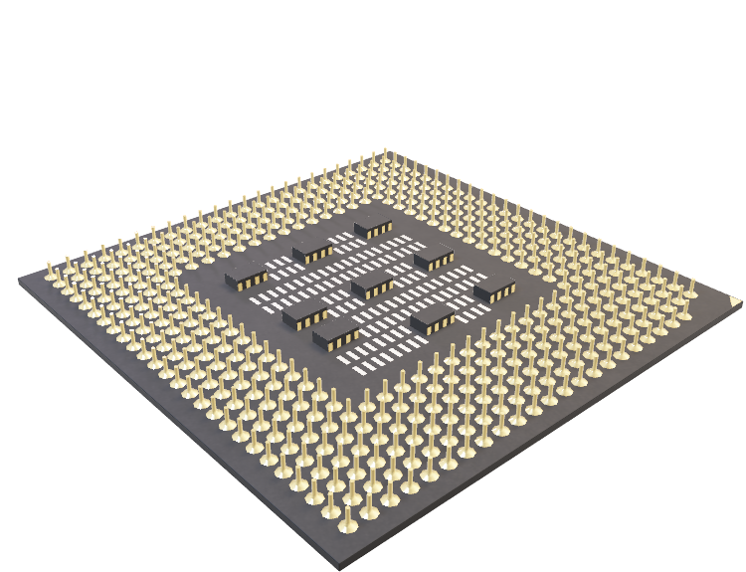
_{Parallel Computing Project}
Parallel Search Engine using MPI
Name: Chirag Anil Kathoye
Reg ID: 201080045
Subject: Parallel Computing
Department: Information Technology
Proff: Prof. Prathamesh Kadam

Slide 2
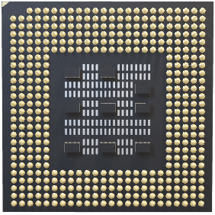
What is Parallel Computing
Parallel computing refers to the use of multiple processors or cores working together to perform a single task or computation. This is in contrast to serial computing, which uses a single processor or core to perform a task sequentially. In parallel computing, the workload is distributed among the processors or cores, allowing for faster and more efficient processing.

Slide 3
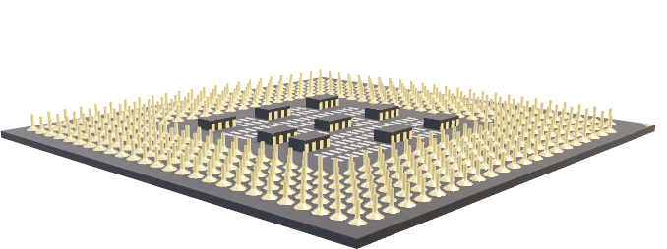
What is a Parallel Search Engine ?
A parallel search engine is a type of search engine that uses parallel computing techniques to improve the speed and efficiency of searching large datasets. This approach involves breaking the search process down into smaller parts and processing them in parallel across multiple processors or cores. By doing so, parallel search engines can significantly reduce the time it takes to search large datasets, making them an important tool for applications such as data mining, information retrieval, and natural language processing.

Slide 4
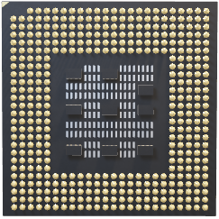
Why Parallel Search Engines ?
A parallel search engine has a wide variety of applications. Generally these techniques are used for large size objects which a serialized engine cannot process or takes a large amount of time for computation.
Web Search Engine
Database analysis
Scientific computing and HPC
DNA sequencing and characteristic matching
Maximizing efficiency and improving quality
Image processing and image-video segmentation

Slide 5
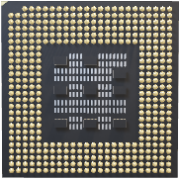
What is MPI
MPI stands for Message Passing Interface, which is a standardized protocol for message-passing parallel computing. It allows multiple processes to communicate and synchronize with each other in order to perform a larger computation in parallel. MPI is widely used in scientific and engineering applications, where large amounts of data need to be processed in parallel across many nodes in a cluster or supercomputer. MPI implementations are available for a wide variety of hardware and software platforms.

Slide 6
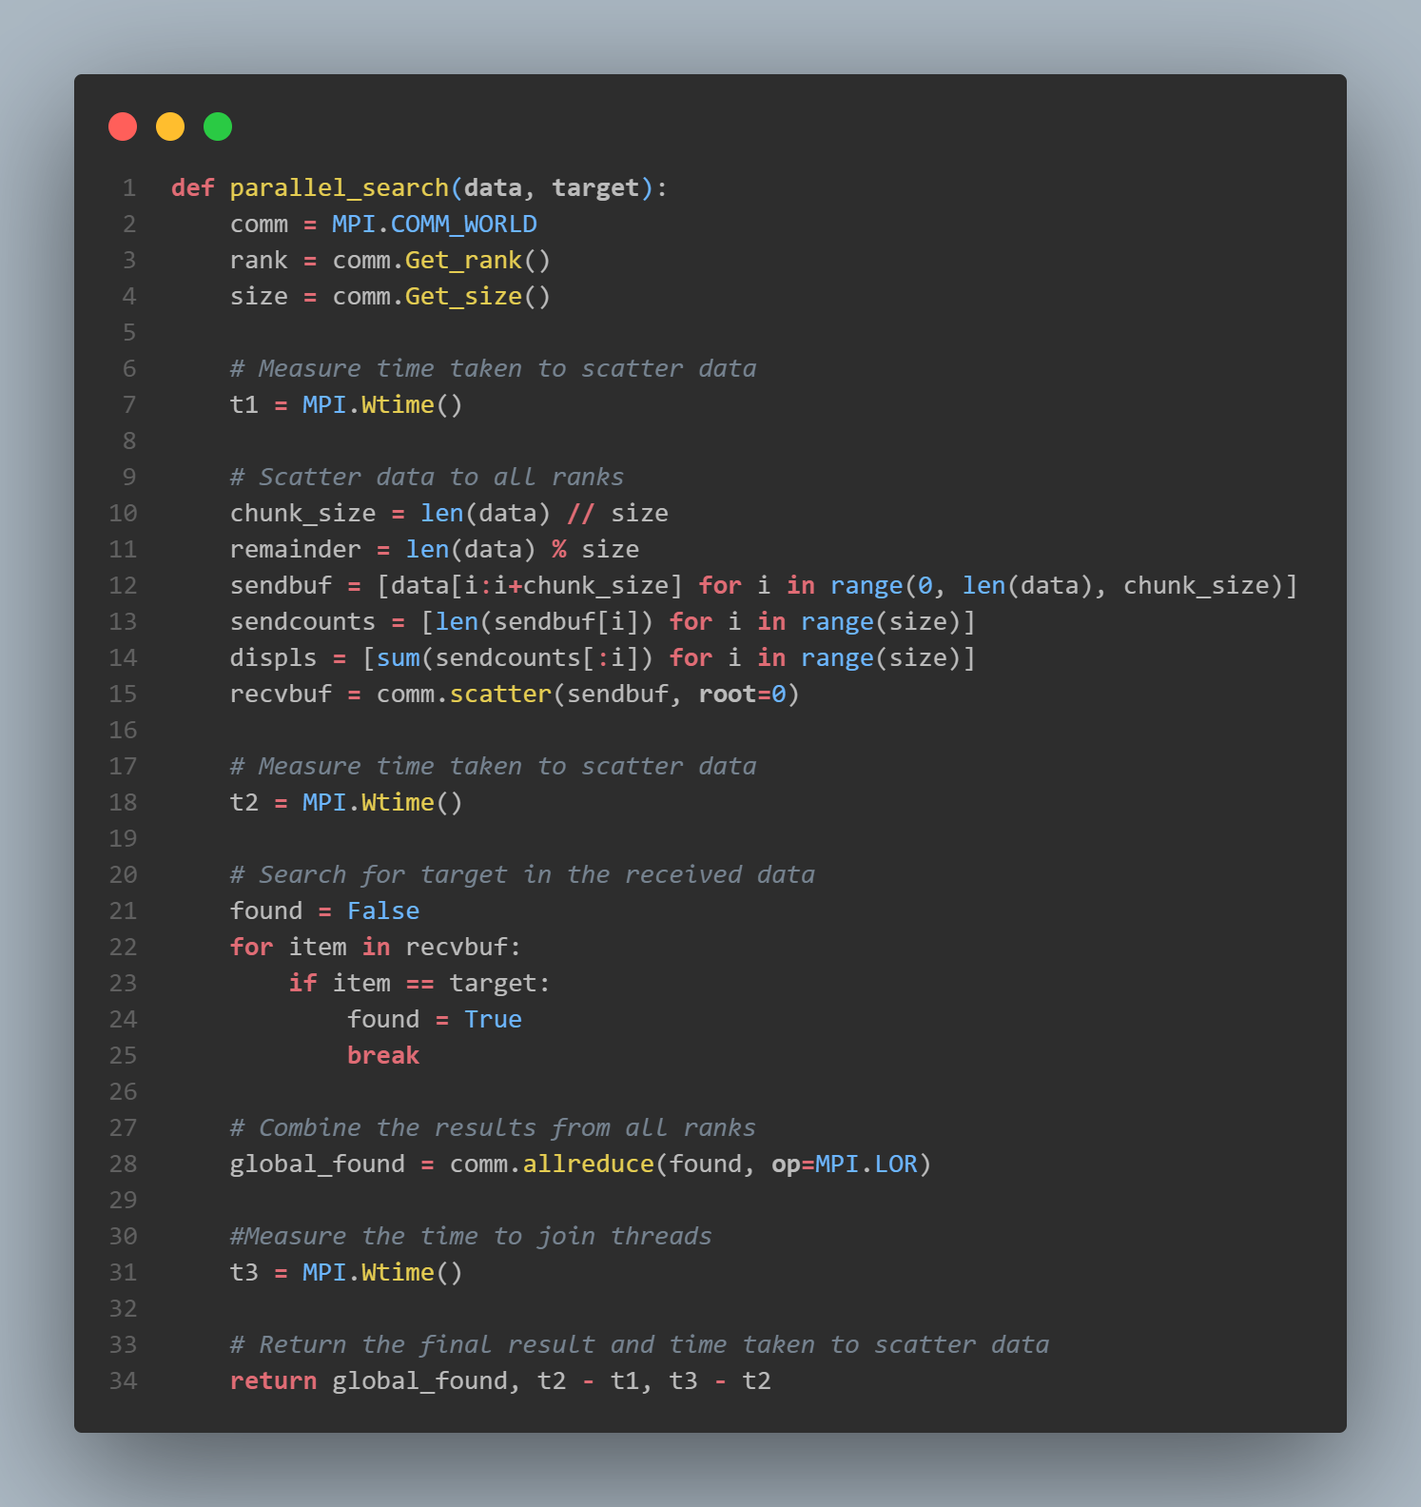
Heart of the Engine: The Parallel Search Function
This is a function for parallel searching a target element in a given list of data using the Message Passing Interface (MPI).
The function scatters the data to all ranks, searches for the target element in the received data, combines the results from all ranks, and returns the final result and time taken to scatter data and join threads.
The function measures time using the MPI.Wtime() function, and uses the comm.allreduce() function with MPI.LOR operation to combine results from all ranks.

Slide 7
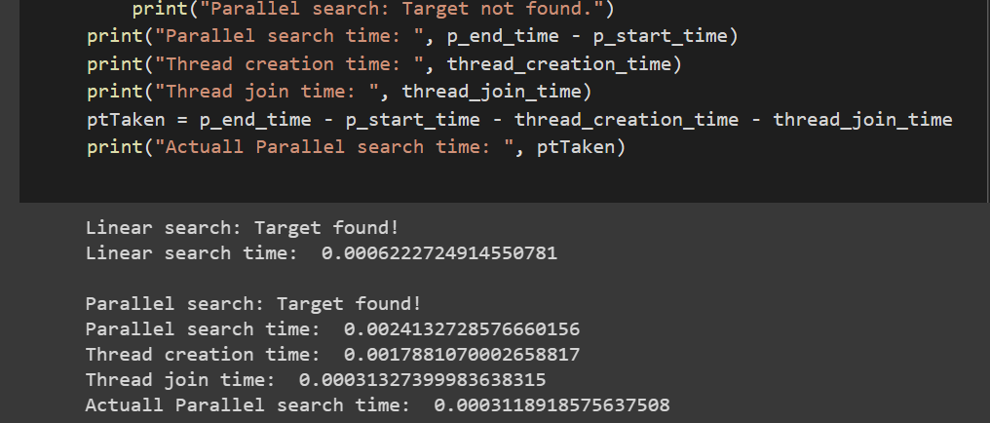
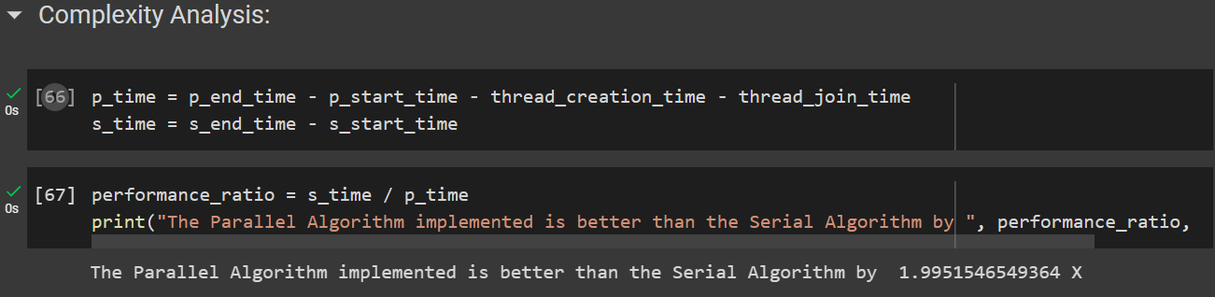
Analysis of Search Engine Created

Slide 8
Observations
We observed here that the Parallel Search engine works almost 2X faster than the Linear/Serial Search engine.
The actual time required for parallel searching is the time taken by the algorithm minus the sum of times required to create and join threads.
On taking the worst case scenario, the ideal maximum values of performances may be obtained.
A parallel search engine is easy to scale and has a wide range of applications:
DNA sequencing and matching
Web search
Faster computation of complex algorithms
HPC
Link to Colabotory

Slide 9
Thank You

